Slide 1

Price Elasticity Approach

Slide 2
Price Elasticity of Demand (PED) and its Benefits
Price elasticity of demand is a measure of the extent to which the quantity demanded of a good changes when the price of the good changes. To determine the price elasticity of demand, the percentage change in quantity demanded is divided by the percentage change in price (Patrick L. Anderson, 2016).
PED classifications
Highly Elastic : Elasticity coefficient <= -5 , this means that when price increases by 1%, the demand drops by 5% or more.
Elastic : -4 <= Elasticity coefficient <= - 2, this means that when price increases by 1%, the demand drops by anything between 2% and 4%.
Unit-Elastic : -1 <= Elasticity Coefficient < 0, this means that when price increases by 1%, the drop in demand is very small as it is very close to 0% and 1% decrease.
Inelastic : Elasticity coefficient > 1, this means that when price increases by 1%, the demand increases by more than 1%.
Why Price Elasticity?
Elasticity can help the business understand how much a change in price will affect market behaviors.
Price elasticity of demand can be used to drive GMV as it enables better handle of pricing structure.
It enables the business to know which pricing point can generate the optimum GMV.

Slide 3

Price Elasticity of Demand (PED) and its Benefits

Slide 4
Executive Summary
How will Price Elasticity be beneficial to Department managers?
Elasticity can help department managers understand how much a change in price for the products in their departments will affect market behaviors.
Price elasticity enables better pricing structure, so when department managers understand how a demand for a product will be affected by a price change, it can be used to drive GMV.
It can help department managers to determine which products to put on promotion and which ones not to put on promotion.
Summary of Our Approach
8 months of authorised and uncancelled orders data (Retail) was used for analysis (01 Jan – 31 August ’21).
Within this period of data, 99.8k unique Tsins were identified.
Of all the 99.8k Tsins identified, 63.7k (63.8%) had 2 or more unique price points. The other portion, 36.1k (36.2%) Tsins, had only one unique price point. This portion of Tsins with only one unique price point was not part of the analysis since they had no price change to be able to see how demand changes.
Tsins with 2 or more unique price points were used for the analysis.
Quantity sold was totalled at each unique price point for each Tsin, and a demand curve for each Tsin was analysed.
Quantity was regressed on price to determine elasticity coefficient for each Tsin.
Confidence level was assigned based on the model’s performance on each Tsin. The confidence level for those Tsins with less than 10 unique price points was low because these Tsins had a very limited data (few price changes) for a model to perform well in determining whether they’re elastic or not.

Slide 5
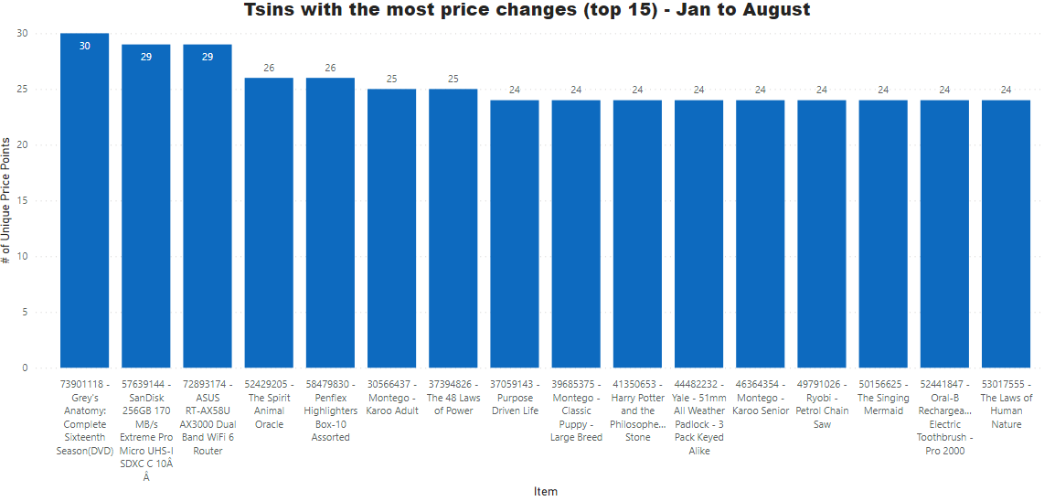
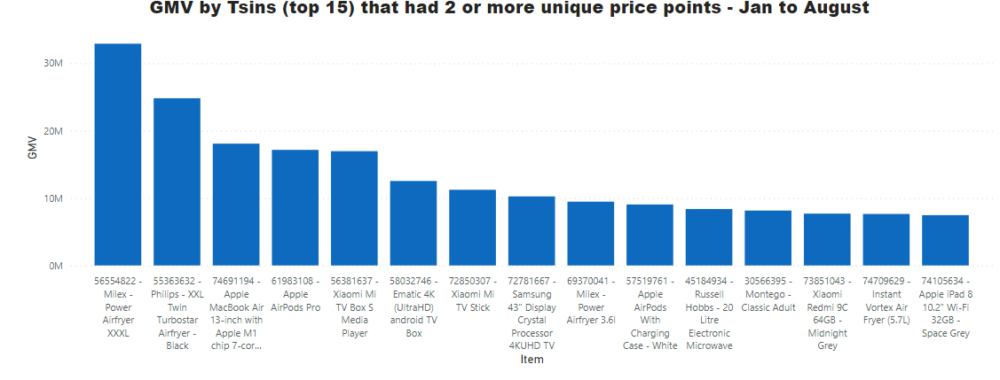
Top 15 Tsins with the most price changes : Jan - Aug’ 21
- These are the Top 15 Tsins from the 63.7k (63.8%) Tsins that had 2 or more unique price points.

Slide 6
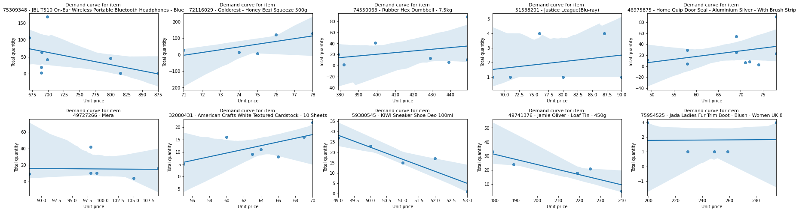
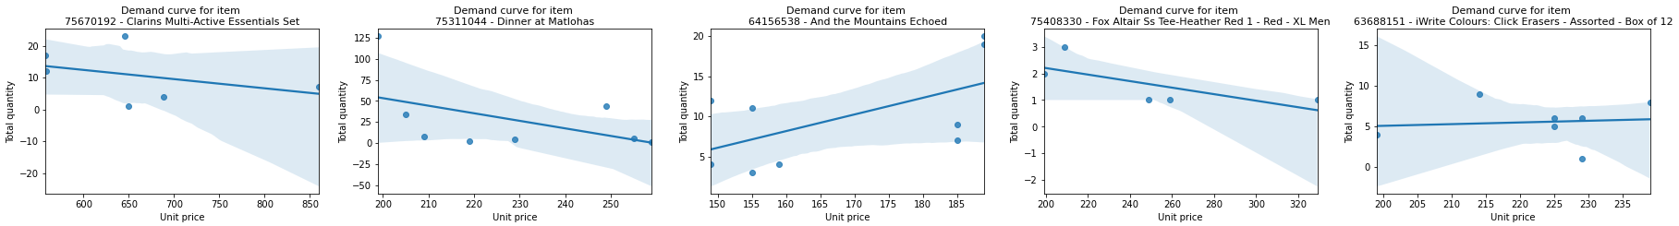
Demand Curves for Tsins (random Tsins)

Slide 7
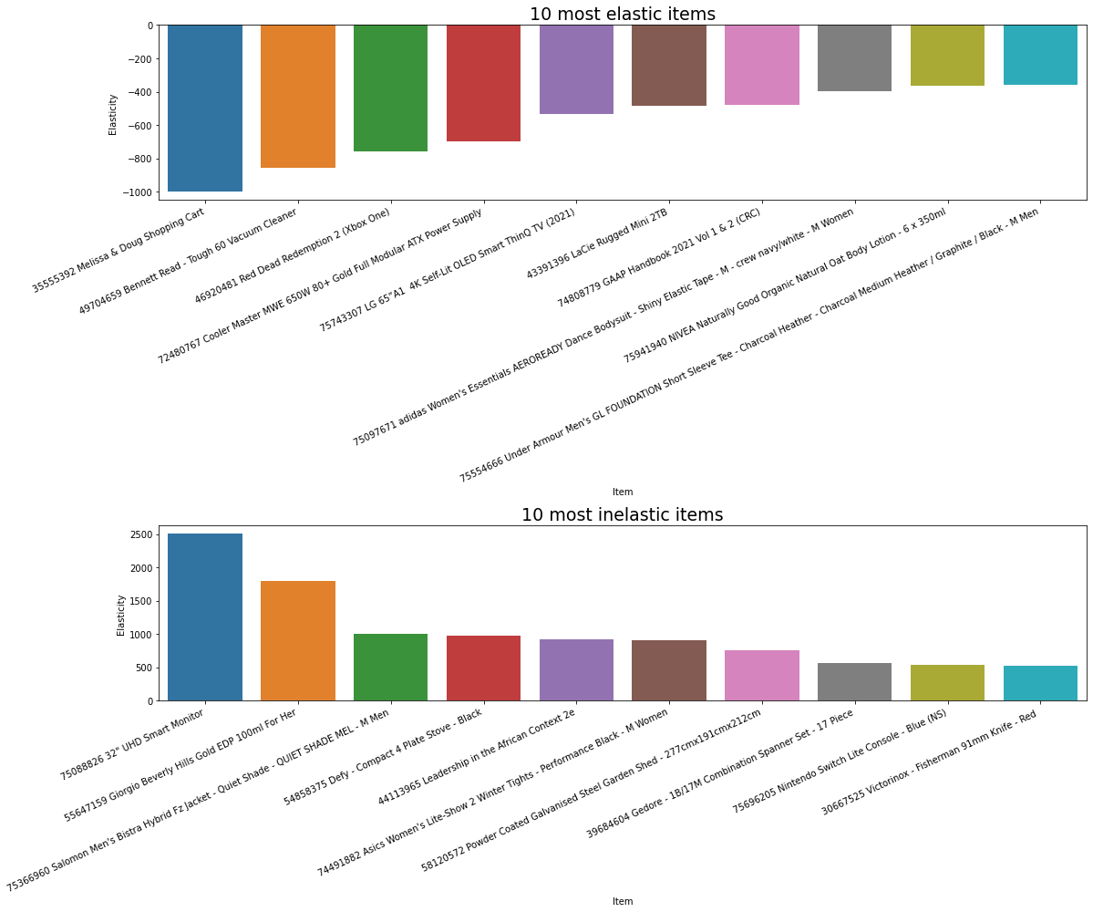
10 Most Elastic and Inelastic Tsins

Slide 8
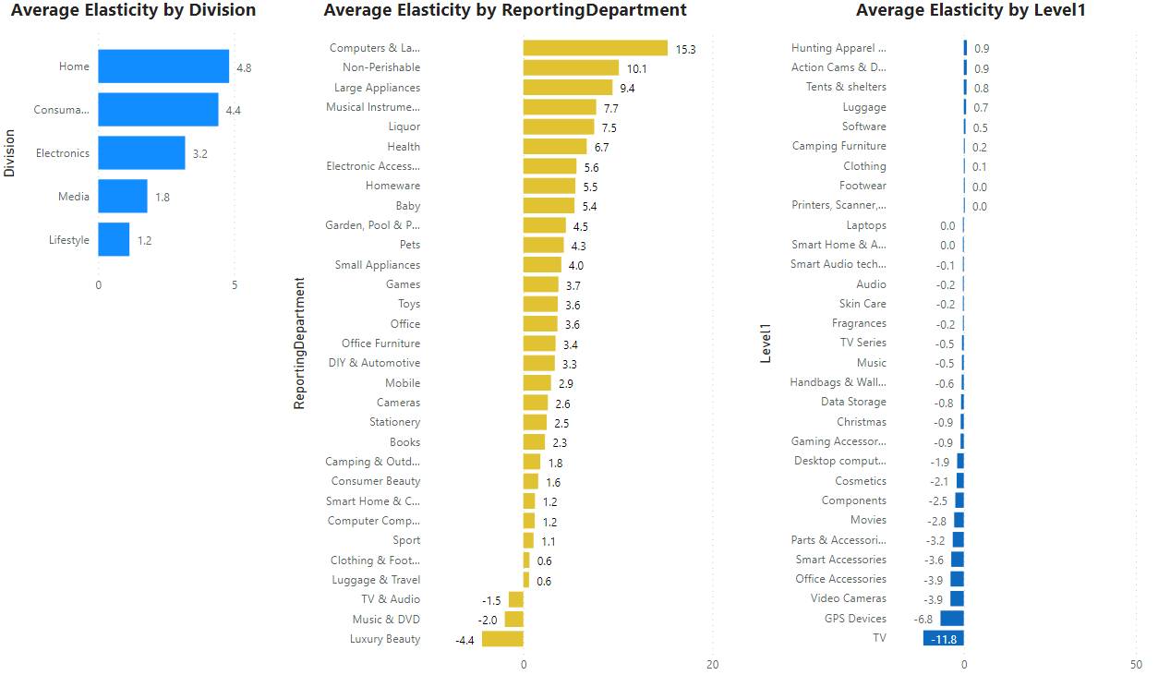
Average Elasticities by Div., Dept. and Level1

Slide 9
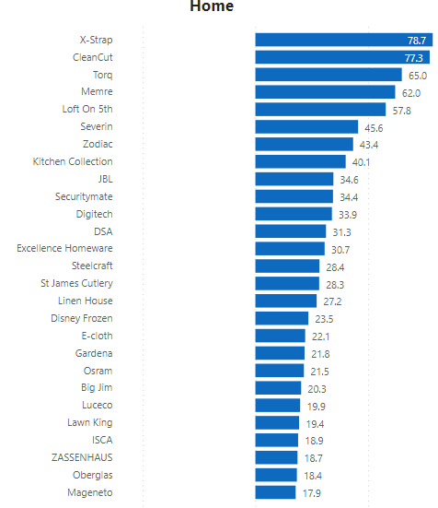
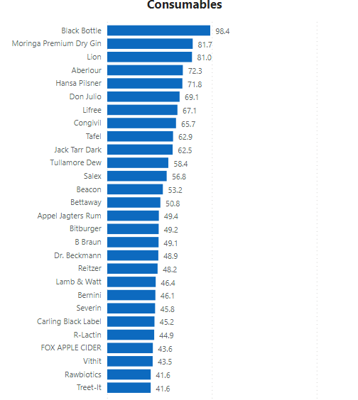
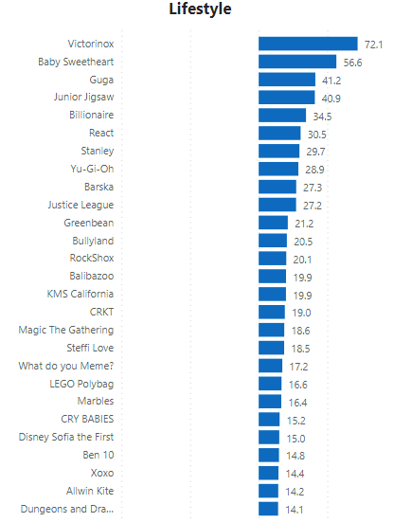
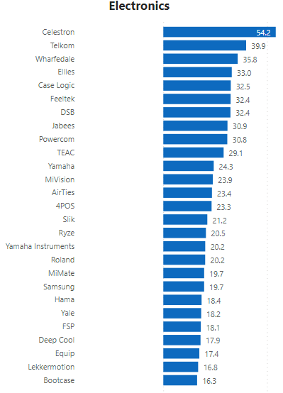
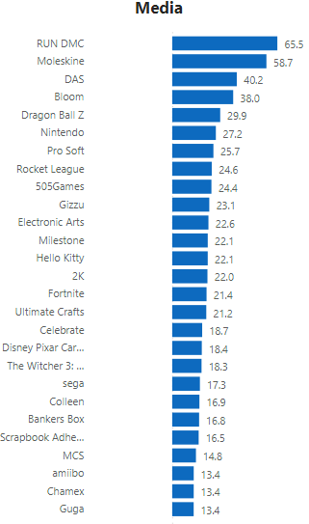
Average Elasticities by Brand Names in each Division –
Top inelastic brands

Slide 10
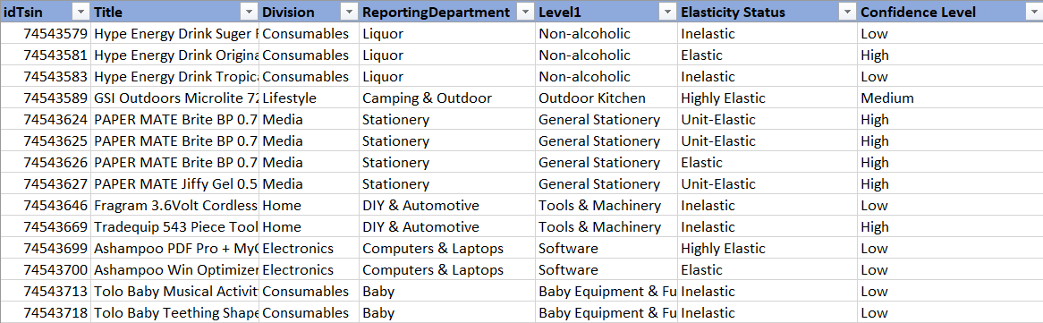
Snapshot of the information that will be sent to Div/Dept managers

